Slide 1

ENHANCING TRUST WITH AI: PRODUCT REVIEW ANALYSIS AND SEGREGATION SYSTEM
TEAM- 04
Y.RISHYENDRA KUMAR
G.ROHITH
T.TARAKESH
T.ANURAG
GUIDE :
Dr. SIVA KRISHNA K

Slide 2
Table of Contents
01
02
03
Objectives &
Techniques
Problem
Statement
Architecture
04
05
SWOT Analysis
Results

Slide 3
Problem Statement
In the realm of online shopping, distinguishing genuine from fake product ratings is a challenging puzzle.
We all rely on star ratings and reviews, but some are fake or biased. Our task is to unravel this mystery, sifting through reviews to identify the trustworthy ones. This matters for buyers and sellers alike. This work builds trust in the online marketplace, benefiting everyone involved.

Slide 4
02
Architecture

Slide 5
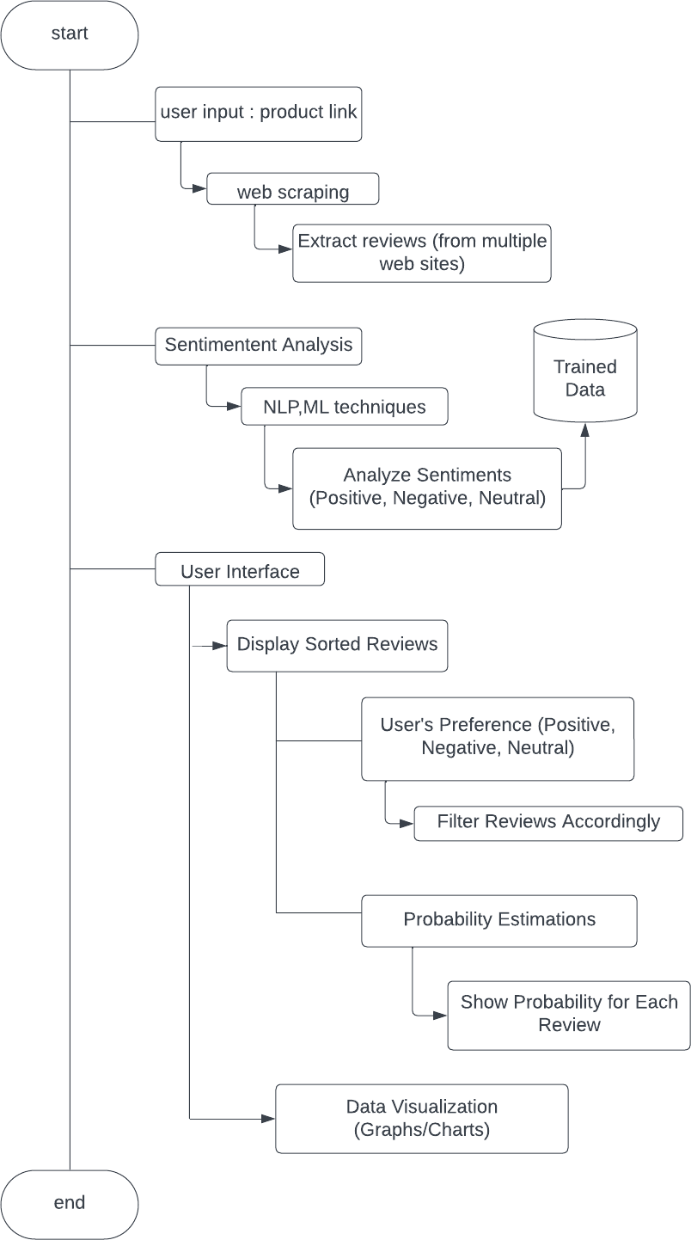
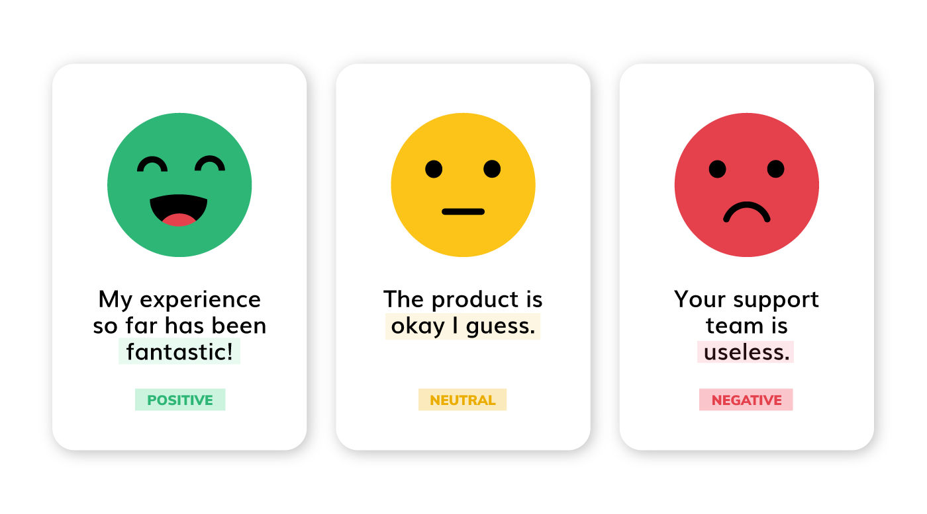
Detailed Architecture
Architecture
Categorizing reviews based upon sentiment analysis:

Slide 6
03
Objectives & Techniques

Slide 7


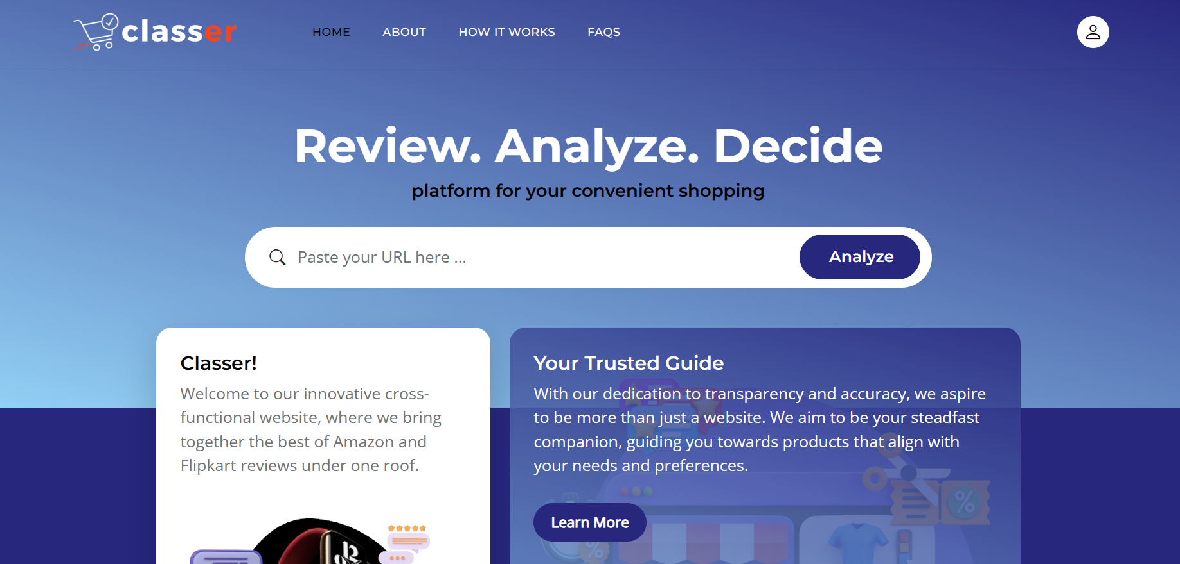
User-friendly interface
Objectives

Slide 8
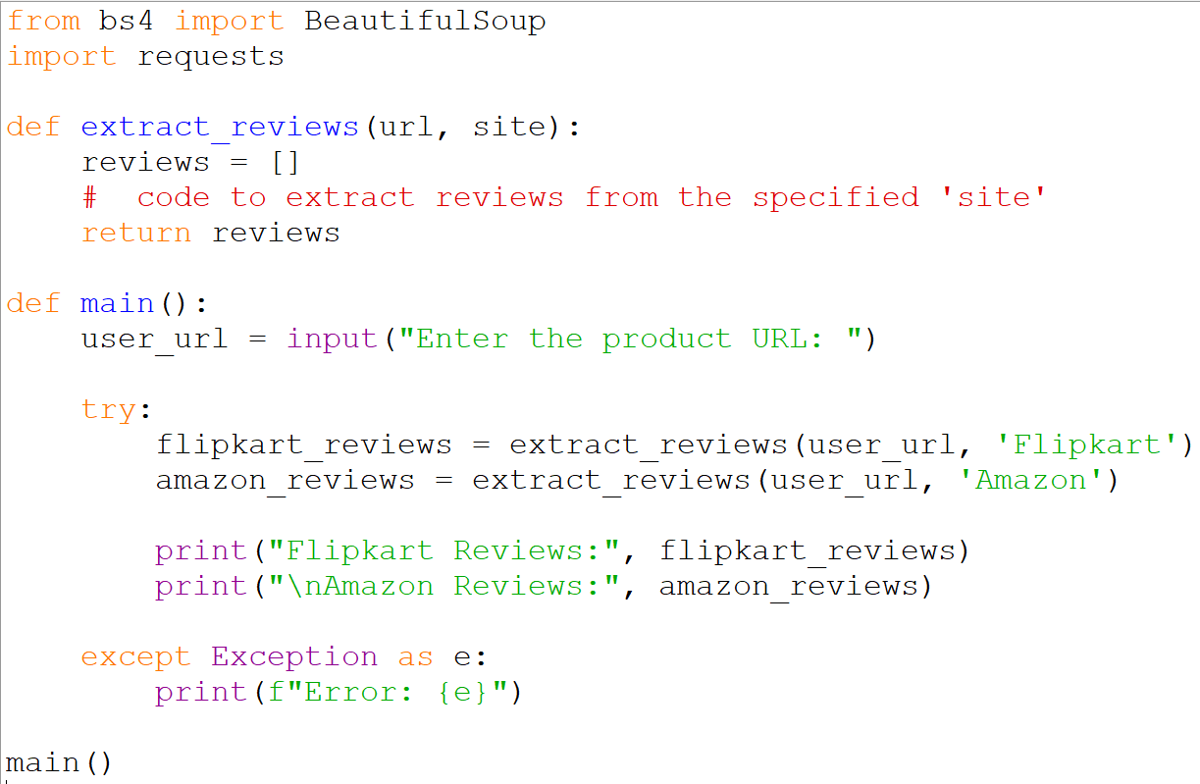

Provide platform-independent review summaries:
Our approach strives to address platform-specific variations that are uniform across multiple online review platforms.

Slide 9
Web Scraping
Step 3
Step 2
Step 1
Implementing Pagination and Data Collection.
Saving Data in JSON Format.
Potential for Error Handling and Logging.
Creating the "pagination" Method.
Defining the "pass" Method.
Storing Data in a Structured Dictionary.
Importing Modules and Classes.
Defining the "reviews" Class.
Setting Up Attributes.

Slide 10
Web Scraping
Importing Modules and Classes:
We begin by importing necessary tools. Utilizing the 'requests-html' library, we can send requests to websites and parse HTML content. Importing the 'HTMLSession' class from this library facilitates our HTTP requests.
Defining the "reviews" Class:
Next, we’ll create a Python class named "reviews" to oversee the entire process. This serves as a blueprint for our scraping code, enhancing organization and code reusability.
Setting Up Attributes:
Within our class, we'll establish the following:
session: Our website connection, managed via an instance of the `HTMLSession` class.
headers: User-agent headers are configured to mimic a standard web browser and avoid scraper detection.
url: The fundamental Amazon product reviews page URL.
Storing Data in a Structured Dictionary:
For every review, we create a neat dictionary with labels like "title," "rating," and "body." This helps us keep things organized and makes it easier to work with the data.

Slide 11

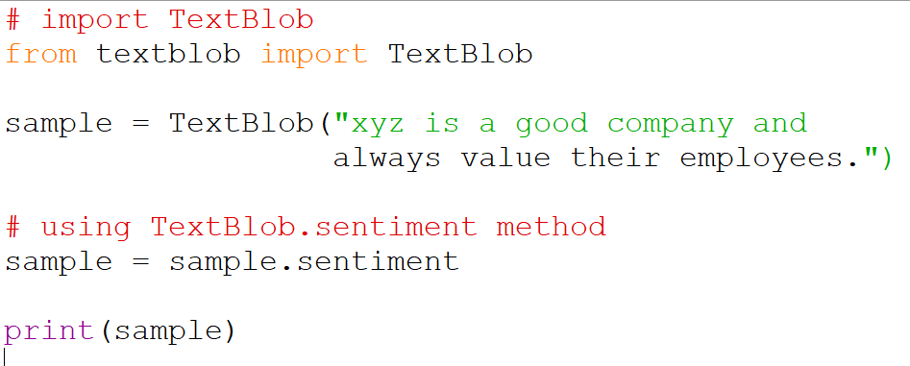
Utilize Advanced NLP and Machine Learning for Sentiment Analysis:
Our model makes use of advanced natural language processing (NLP) and machine learning techniques to perform sentiment analysis on product reviews.

Slide 12
NLP Techniques
NLP involves various techniques to process and understand human language. In this example, NLP would perform tasks like:
Ex: "Absolutely love this phone! The camera quality is fantastic, and the battery life lasts all day."
Tokenization: Breaking the review into individual words or tokens: ["Absolutely", "love", "this", "phone", "..."]
Part-of-Speech Tagging: Identifying the grammatical roles of words: "Absolutely" (Adverb), "love" (Verb), "this" (Pronoun), ...
Named Entity Recognition: Identifying entities like "phone" as a product.
Sentiment Analysis: Determining the sentiment of the text as positive due to positive words like "love," "fantastic," and "lasts all day."

Slide 13

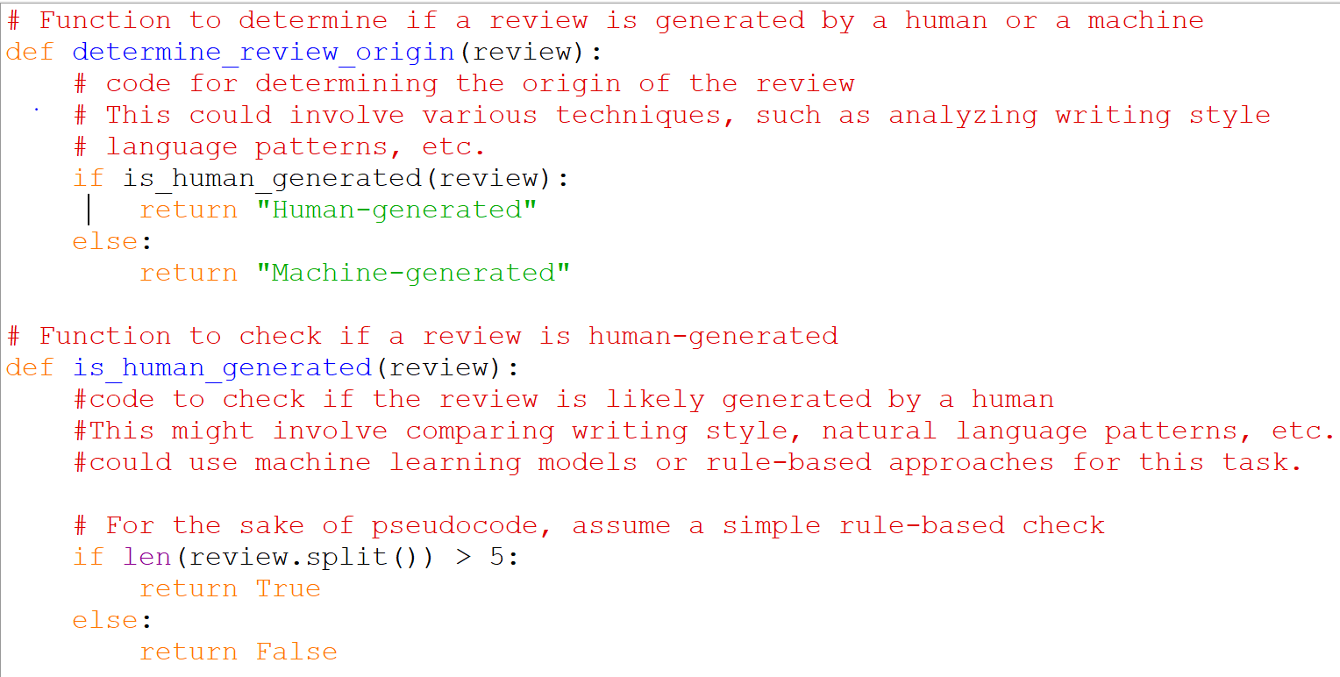
Distinguish between human and bot-produced reviews
Another essential goal of our system is to determine whether a review was generated by a human or a machine.

Slide 14
Probability Estimation for Review Authenticity
Building a plagiarism detection model to differentiate between AI-generated and real human reviews involves similar principles as a general plagiarism detection model. The key difference is that you'll be focusing on detecting similarities between AI-generated text and authentic human-generated text. Here's how you can approach it:
Example: Let's say you have a dataset of product reviews, some of which are written by AI models and some by humans. You preprocess the text, tokenize it, and convert it into TF-IDF vectors. Then, you use cosine similarity to compare each AI-generated review to the human-generated reviews.
- AI-generated review: "This product is exceptional!“
- Human-generated review 1: "I'm thoroughly impressed with this product.“
- Human-generated review 2: "What an outstanding product!"
You calculate the cosine similarity between the AI-generated review and the two human-generated reviews. Let's assume the similarity scores are as follows:

Slide 15
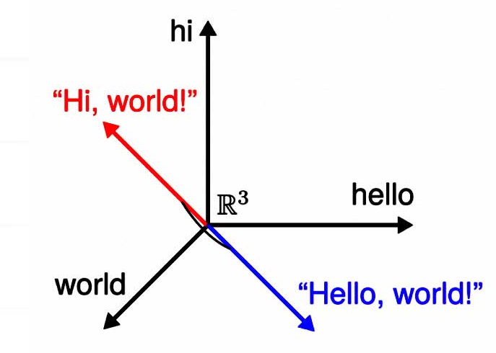
Probability Estimation for Review Authenticity
- AI vs Human review 1: Cosine similarity = 0.85
- AI vs Human review 2: Cosine similarity = 0.70
Now, you compare these similarity scores against your threshold. If your threshold is set to 0.8, you would classify the AI-generated review as potentially plagiarized from the human-generated review 1, as its similarity score exceeds the threshold.

Slide 16
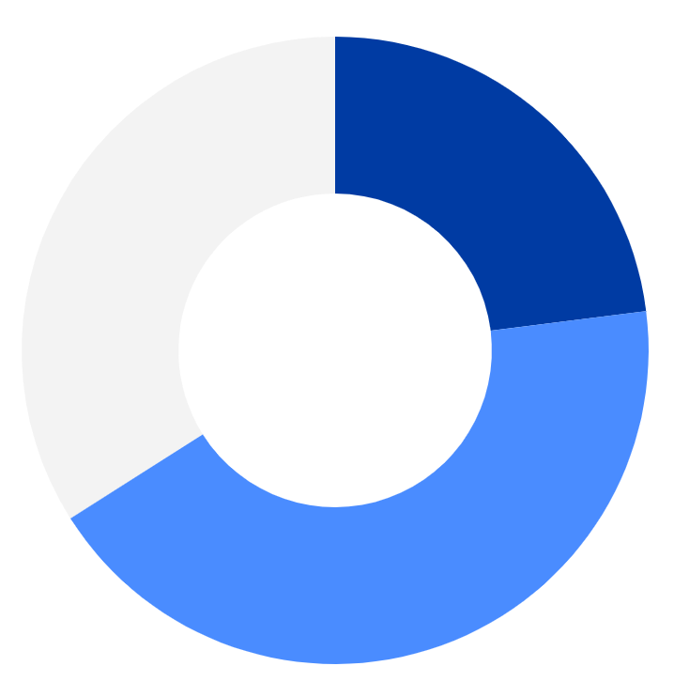
Data Visualization
The system uses interactive data visualization tools like Matplotlib or Plotly to display easy-to-understand graphs and charts. For example, using Matplotlib, it can create attractive pie charts illustrating the distribution of Positive, Negative, and Neutral sentiments in reviews.
These visuals engage users and offer a concise overview of product sentiment trends.
Negative (23%)
Positive (43%)
Neutral (34%)
Review Analysis

Slide 17
Visualizing Key Features
55%
80%
60%
‘Analysing the key features from reviews of an android mobile’
“Better Battery Life”
“Great! Performance of Processor is very good, handles high end applications.”
“Worth for money”

Slide 18
04
SWOT Analysis

Slide 19




STRENGTH
Human Bot Reviews Identification
Interactive Dashboards
Understandable data visualization
WEAKNESS
Accuracy
Dependency on Visualization
Complex for Non-Tech Users
OPPORTUNITIES
E-commerce collaborations
User education
AI-driven Personalization
THREATS
Ethical concerns
Advancement in Technology
Seamless updates

Slide 20
05
Results

Slide 21
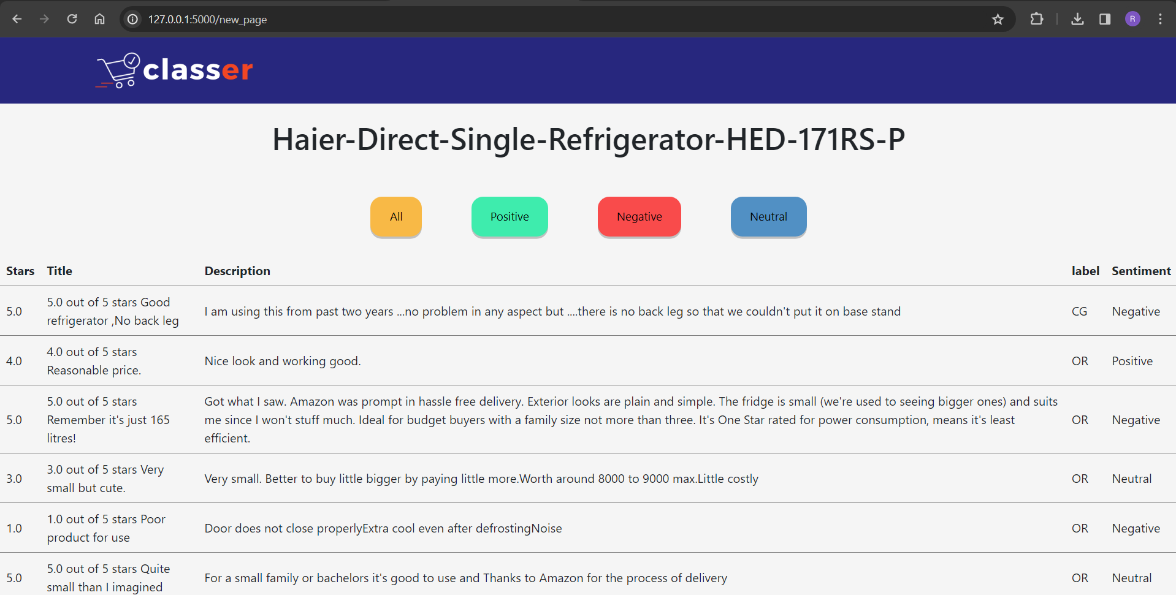
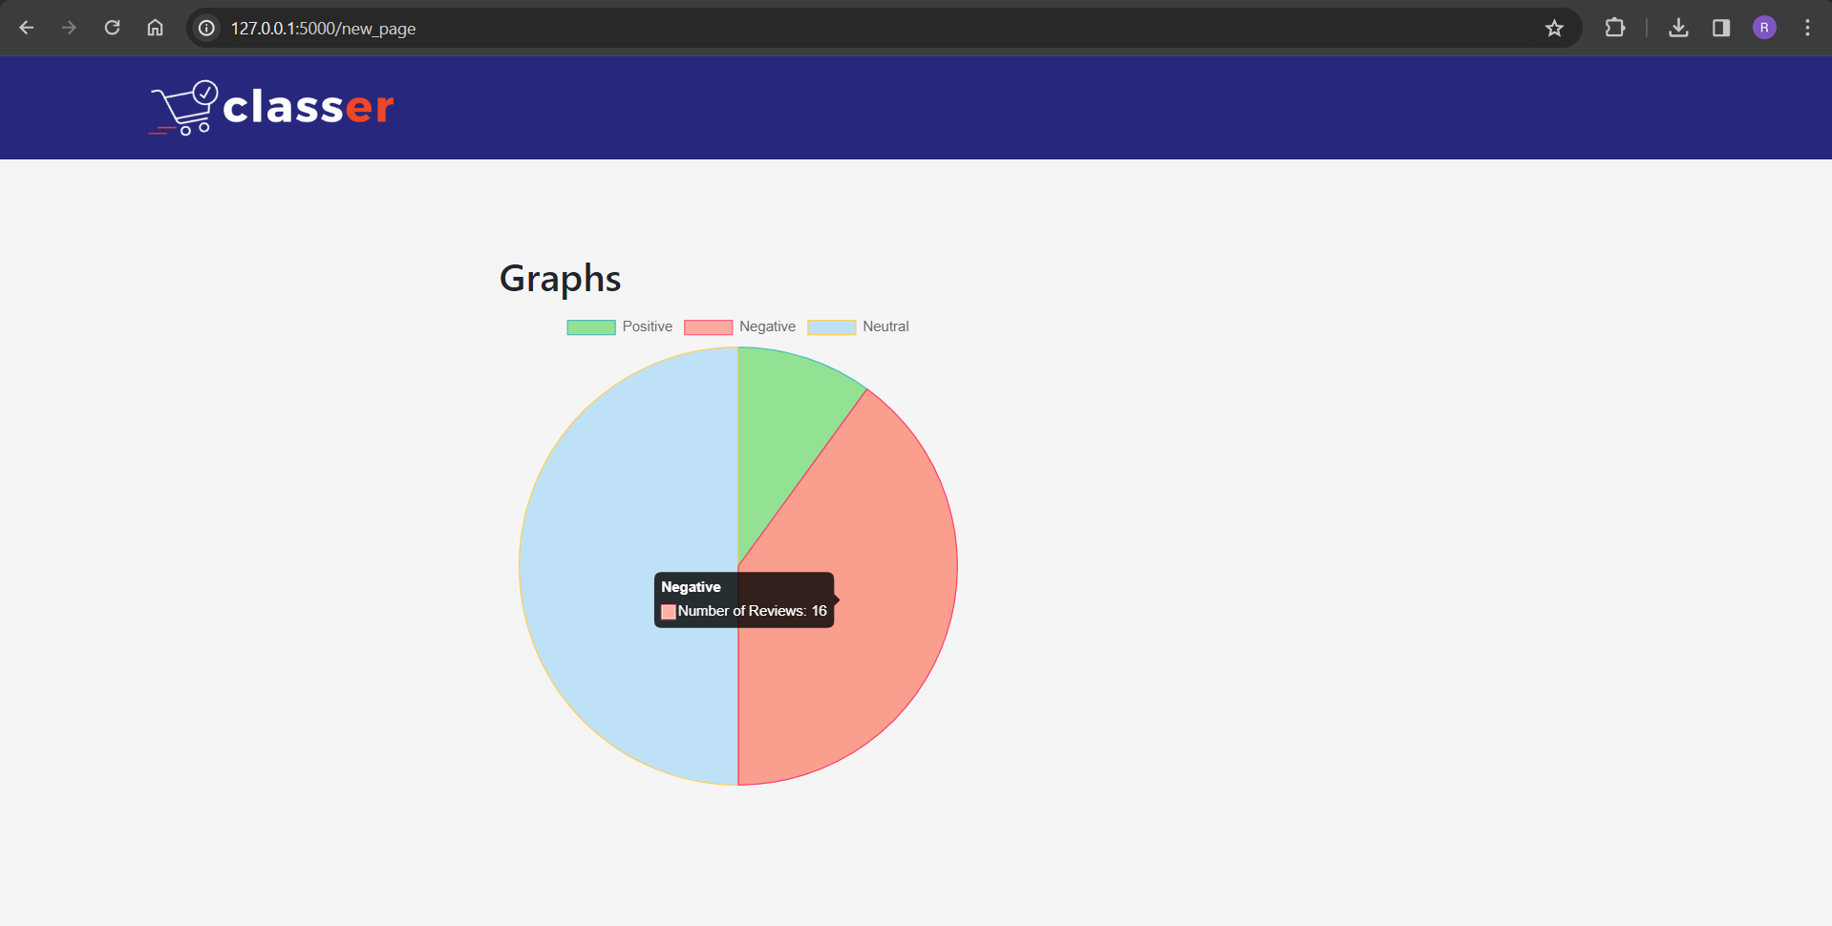
Classified resultant reviews of product
Visualizing results through pie charts

Slide 22
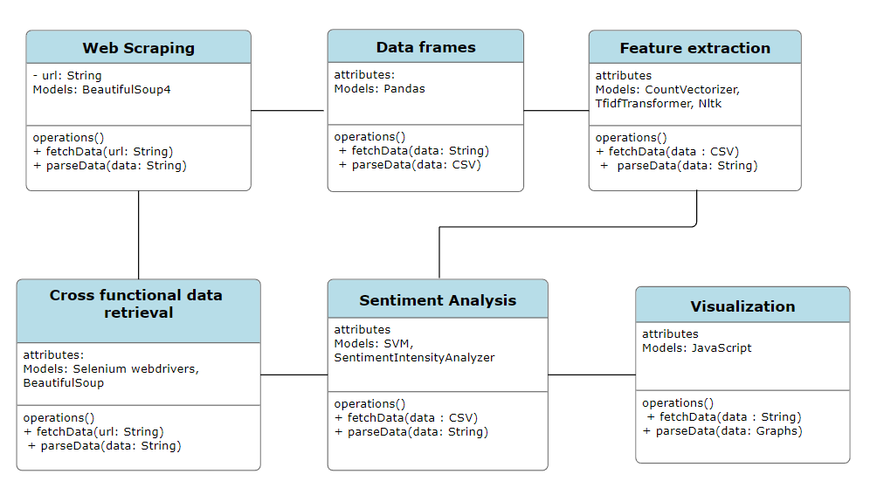
UML Diagrams

Slide 23
Thanks
Any Queries ?
Please keep this slide for attribution

